Slide 1

TOTAL QUALITY MANAGEMENT & SIX SIGMA · FORTUNE INSTITUTE OF INTERNATIONAL BUSINESS
Reducing Rejections and Improving quality In SKH Metals Pvt Ltd by Implementing
DMAIC Six Sigma
A Six Sigma Study of the Press-Forming Process
SKH Metals Ltd., Kharkhoda, Haryana | Tier-1 Sheet-Metal Supplier to Maruti Suzuki India Ltd.
Presented by Anuj Kaushik
Term IV · Batch 2025-27 · Faculty: Dr Akansha Jain

Slide 2
EXECUTIVE SUMMARY
The 27-Defect Story, In Four Numbers
1,721,184
2785
4.5σ
4.99σ
Units Inspected
Total Rejections
in 30 days
Baseline Sigma
Level
Targeted Sigma
Level
Days 1–31 baseline
SKH Metals' press-shop logs 27 defect types a month. Crack and Flange Short - the 2nd and 3rd largest categories are the only high-volume defects directly traceable to press-tooling and material root causes, so they anchor this DMAIC study. The 31-day baseline shows the process is statistically unstable; five prioritised root causes and five corrective actions point to a realistic reduction.
D
M
A
I
C
Define
Measure
Analyse
Improve
Control
Charter, SIPOC, CTQs
Baseline sigma & p-chart
Fishbone + root-cause rank
Impact-Effort action plan
KPI dashboard & plan
SKH Metals — DMAIC Six Sigma Project
2

Slide 3
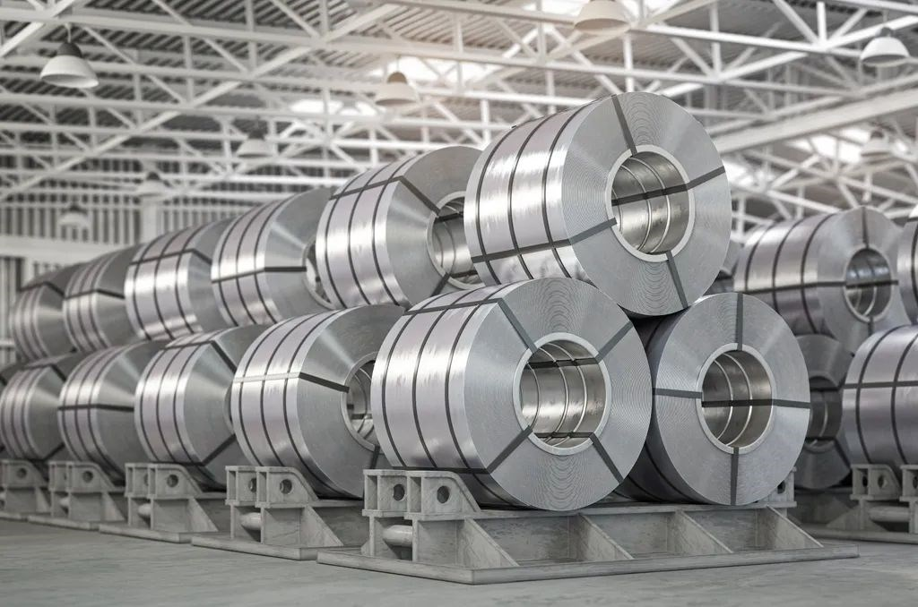
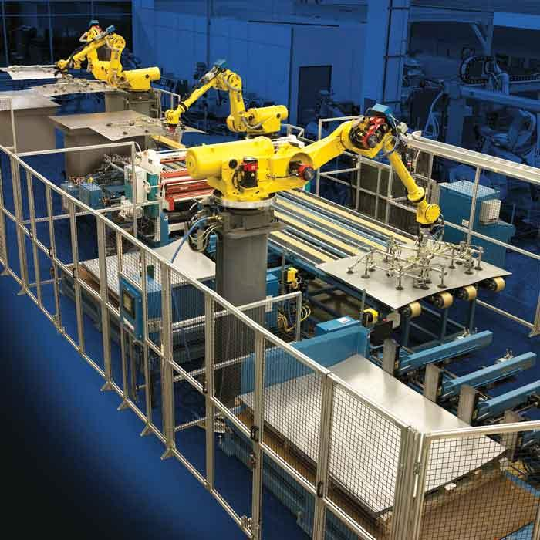
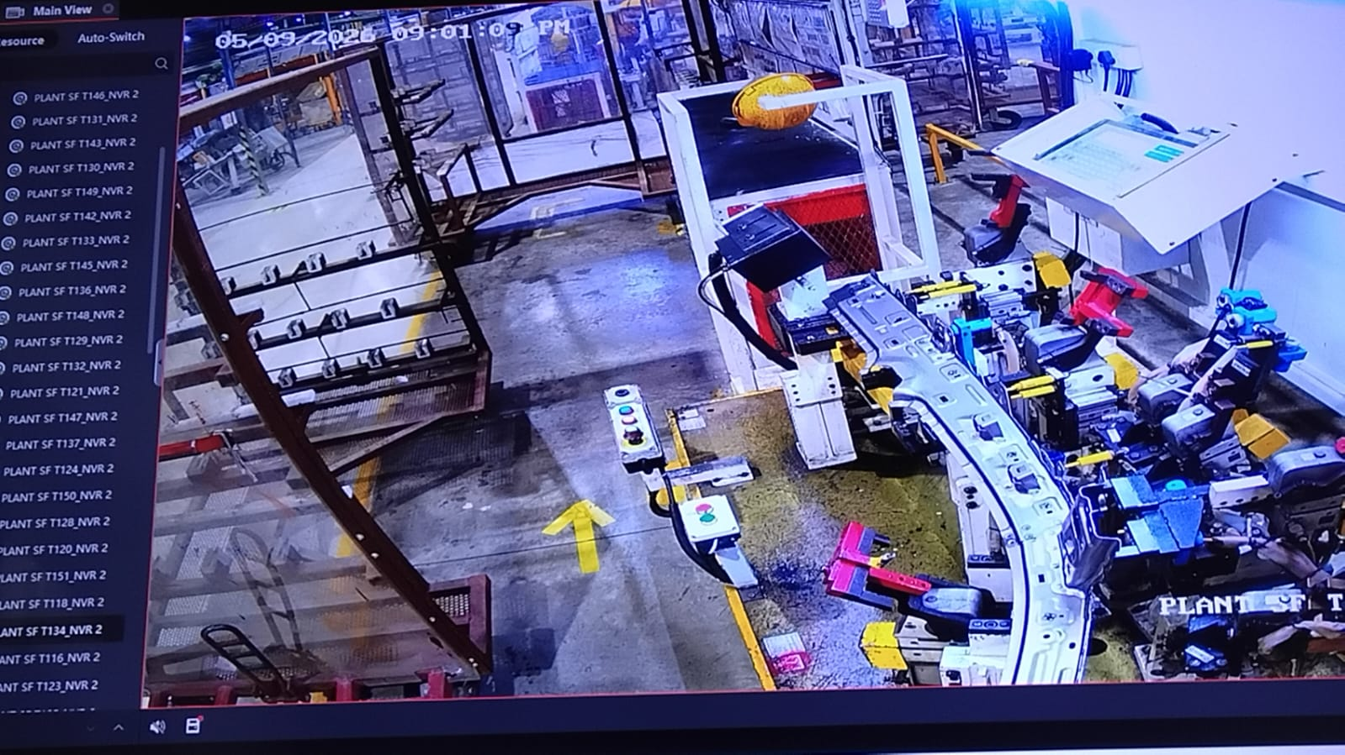
PROCESS CONTEXT
SIPOC - Press-Forming Process
SUPPLIERS
INPUTS
PROCESS
OUTPUTS
CUSTOMERS
Tata Steel
(CR steel coil)
CR steel coil
Die & punch tooling
Lubricant
Uncoiling & blanking
Press-forming (draw)
Flanging / trimming
In-line dimension check
Pack & dispatch
Pressed sheet-metal
chassis / body part
Maruti Suzuki India Ltd.
(assembly line)
Critical to Quality (CTQ): no visible crack or fracture on the panel/flange radius · flange height within drawing tolerance · on-time delivery of conforming parts
SKH Metals — DMAIC Six Sigma Project
3

Slide 4
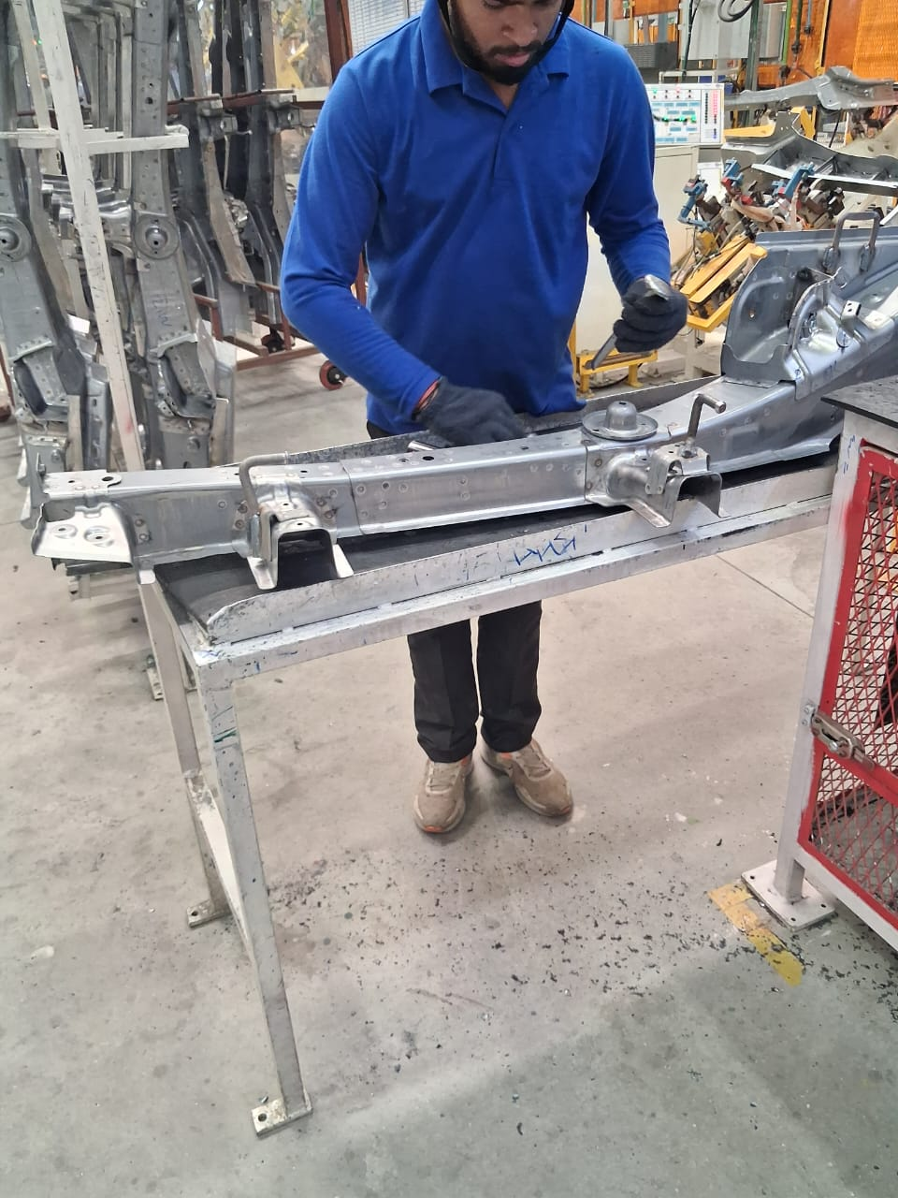
DEFINE
Problem Statement & Project Charter
D
Problem Statement
Project Charter
SKH Metals' press-shop is experiencing persistent rejections on Maruti Suzuki chassis parts. These defects consume material, rework capacity and inspection time, and risk an in-line stoppage at the customer if an escaped defect is detected downstream.
GOAL
Checking the Causes and Reducing the defects which contribute more to the rejections while increasing the sigma level 4.50 → ~4.99
Business Impact
SCOPE
Scrap & rework cost on every rejected piece
Defects across all 31 days — an uncontrolled, not one-off, source of variation
Press-forming & flanging only — excludes anodizing, welding, final-fitting
TIMELINE
1 months (Measure–Analyse: 2 wks; Improve: 1 wks; Control: ongoing)
TEAM
Quality Head · Press-shop Supervisor · QA Inspector · Student Project Team
SKH Metals — DMAIC Six Sigma Project
4

Slide 5
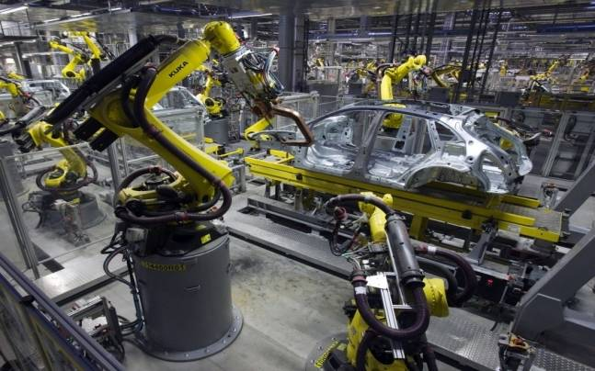
MEASURE
Selecting the Vital Few Defects
M
Why These Two?
Of 27 defect categories (2,785 rejections / 1.72M units in May 2026), Misfeed and Setting are handling errors. Flange Short (308) and Crack (300) are the top process-quality defects - both traceable to press/die/material causes a Six Sigma project can act on.
300
308
Crack units
Flange Short units
(31-day totals, all models)
Scope Decision: Misfeed (859) and Setting (285) are excluded because they are pre process and handling defects; Crack and Flange Short are in process, forming defects. Ranking third and second by volume, they're also large enough that fixing them is worth the effort, but the selection criterion is defect mechanism, not just rank.
SKH Metals — DMAIC Six Sigma Project
5

Slide 6
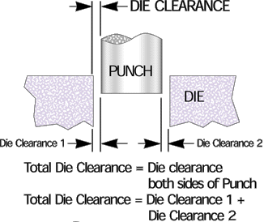
MEASURE
Baseline Performance (Days 1–31)
M
Process Not Yet Stable
UCL/LCL vary daily with sample size. 6 of 31 days (2, 5, 13, 15,17,23) fall outside the control limits - special-cause variation confirms root-cause analysis is needed, not just tighter monitoring.
4.50σ
Baseline Sigma Level
Sigma Level = (Total Inspected – Total Rejected) ÷ Total Inspected = 99.8%
( Now we will look for the value of 99.8% in yield to sigma level table )
Excel Link
SKH Metals — DMAIC Six Sigma Project
6

Slide 7
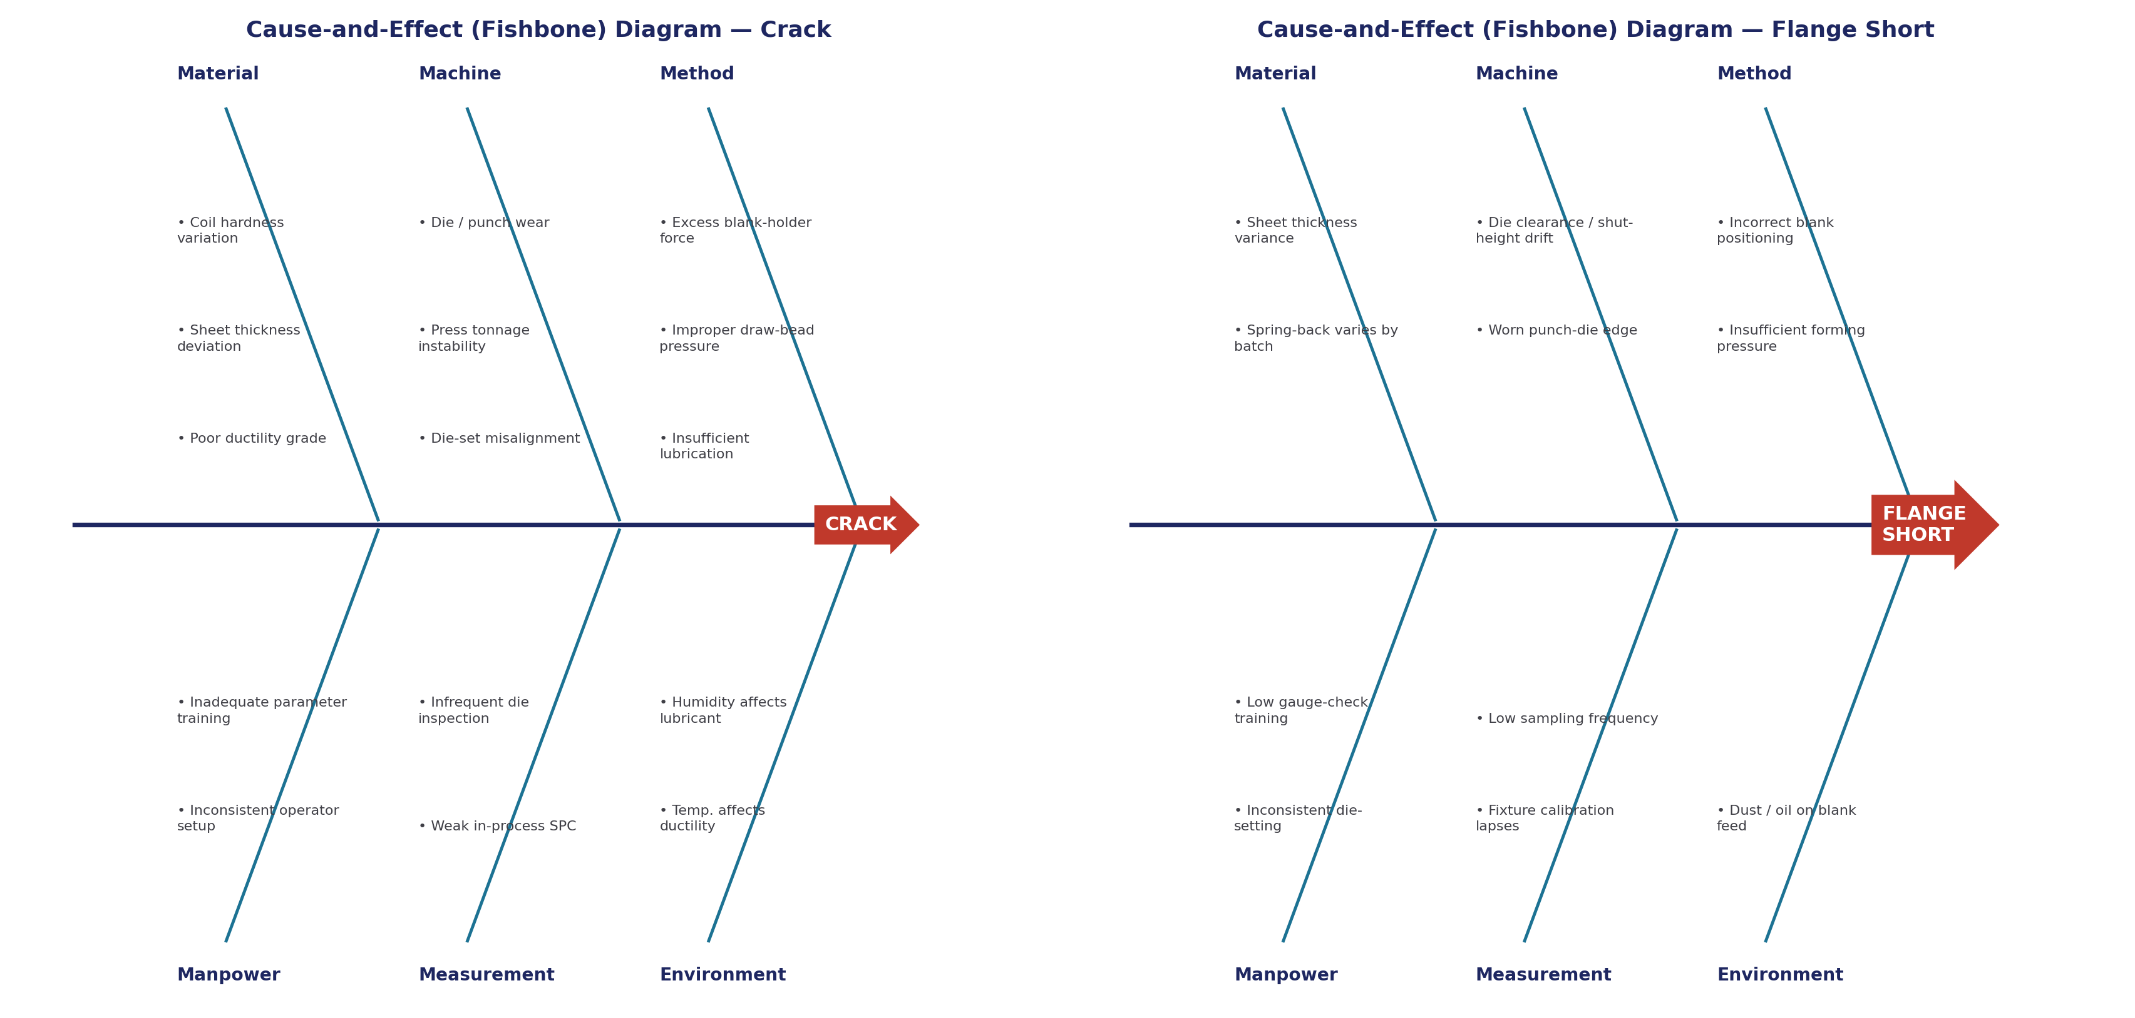
ANALYSE
Root-Cause Diagrams (Fishbone / Ishikawa)
A
SKH Metals — DMAIC Six Sigma Project
7

Slide 8
ANALYSE
Prioritising the Root Causes
A
Rank | Root Cause | 6M Category | Linked Defect | Priority
1 | Die / punch wear and clearance drift | Machine | Crack + Flange Short | 9
2 | Coil hardness / thickness variation from supplier | Material | Crack + Flange Short | 8
3 | Inconsistent operator die-setting | Manpower | Flange Short | 7
3 | Lack of standard SOP & in-process SPC | Method / Meas. | Crack | 7
5 | Inadequate preventive maintenance schedule | Machine | Crack | 6
Key Insight: Each cause was scored on two dimensions before ranking: breadth of impact - whether the cause drives both Crack and Flange Short or only one - and frequency of occurrence — how consistently it appears across inspection days rather than as an isolated event.
Die/punch wear and coil-material variation score highest and are common to both defects - they anchor the Improve-phase action plan, with operator-setup and SOP gaps as supporting fixes.
SKH Metals — DMAIC Six Sigma Project
8

Slide 9
IMPROVE
Corrective Actions
I
Code | Corrective Action | Root Cause | Impact | Effort
CM1 | Scheduled die/punch maintenance & wear-tracking log | RC1, RC5 | 8/10 | 3/10
CM2 | Tighten incoming coil hardness/thickness spec & SPC with Tata Steel | RC2 | 9/10 | 8/10
CM3 | Standard die-setting SOP with pictorial work instructions | RC3, RC4 | 7/10 | 2/10
CM4 | Digital press-force gauge / poka-yoke parameter monitoring | RC1, RC4 | 8/10 | 7/10
CM5 | Operator training & certification on press set-up and gauge check | RC3 | 6/10 | 3/10
Lean sustaining tools: 5S at the die-setting workstation (Sort · Set in Order · Shine · Standardise · Sustain) removes setup variability behind RC3; a Value Stream Map of coil-receipt → forming → flanging → dispatch confirms CM1–CM5 remove rework loops rather than shift them downstream.
SKH Metals — DMAIC Six Sigma Project
9

Slide 10
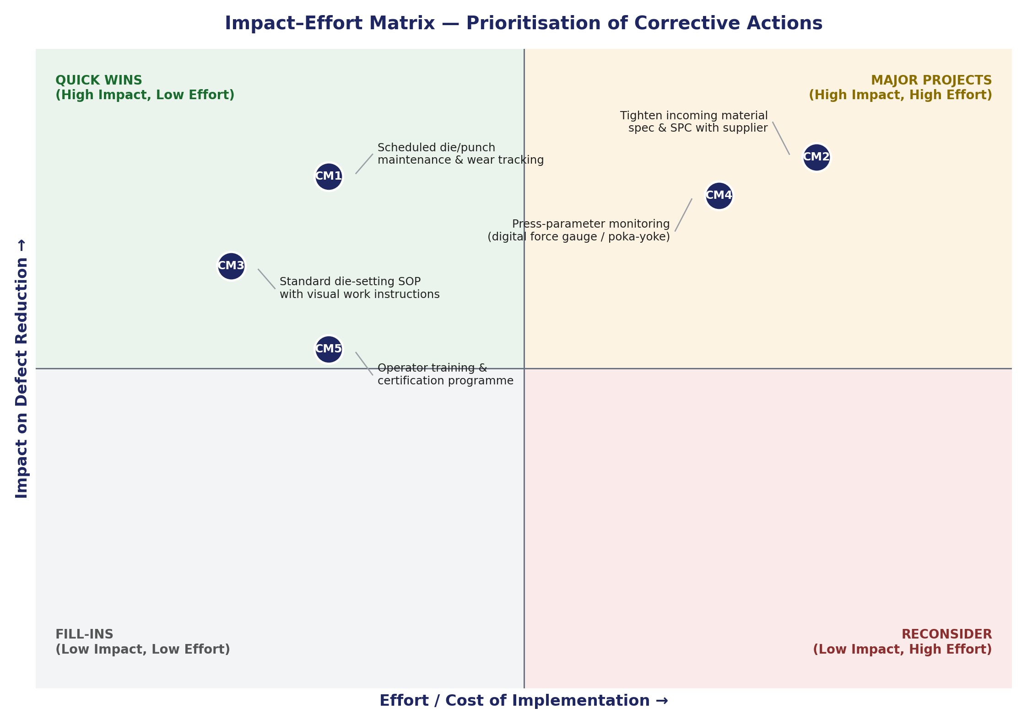
IMPROVE
Prioritising Implementation
I
Implementation Sequence
Trial 1 — Quick Wins (Weeks 1–3)
CM1, CM3, CM5: standard SOP, PM log, operator training. Low cost, existing resources.
Trial 2 — Major Projects (Weeks 4–9)
CM2, CM4: renegotiate Tata Steel material spec; pilot digital press-parameter monitoring on one line.
Expected Outcome
Sigma Level 4.50 → ~4.99
SKH Metals — DMAIC Six Sigma Project
10

Slide 11
CONTROL
Sustaining the Gains
C
Process Step | Control Item | Freq. | Owner
Die & Punch | Die wear / clearance | Daily | Shift I/C
Incoming Material | Coil hardness & thickness | Per lot | QA Inspector
Press Process | Fraction defective (p-chart) | Daily | Quality Engineer
Press Process | Sigma Level | Weekly | Quality Head
Operator / SOP | SOP adherence (LPA) | Weekly | Line Supervisor
KPIs to Sustain
Process Sigma Level: tracked weekly; target ≥ 4.99σ
Preventive-maintenance (PM) compliance for dies: target 100%
Incoming-material rejection rate from Tata Steel: tracked per lot
Ownership passes to the Quality Head at project close. p-chart and PPM/Sigma reviews slot into existing shift-handover and weekly quality-review meetings — no new cadence required.
SKH Metals — DMAIC Six Sigma Project
11

Slide 12
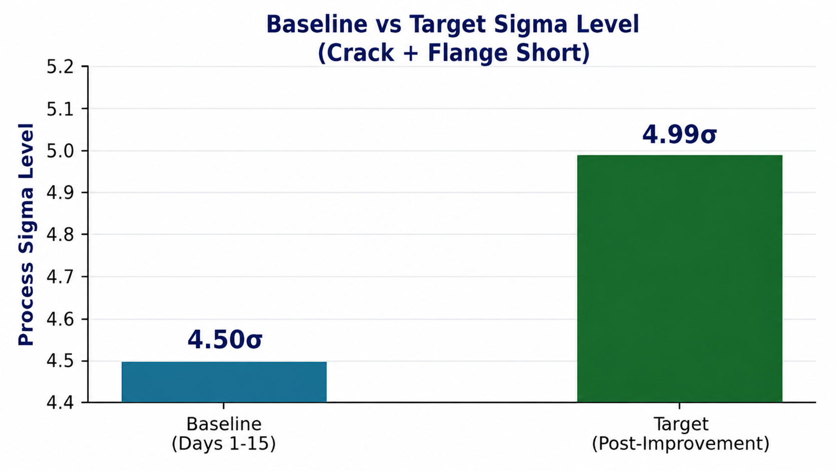
RESULTS & CONCLUSION
From Ad-Hoc Rejections to a Controlled Process
Fishbone analysis and root-cause prioritisation pointed to die/punch wear and incoming coil-material variation as the leading causes behind Crack and Flange Short. Five corrective actions, sequenced by an Impact-Effort matrix lifting the Sigma Level from 4.50 to approximately 4.99, sustained through the Control-phase KPI dashboard.
Key learning: at very large inspection volumes, even a small fraction defective implies a high underlying Sigma Level — the real value of DMAIC here is converting an ad-hoc rejection log into a structured, data-driven, sustainable response.
12

Slide 13
Thank You
Questions & Discussion
Anushka Nagar · Anuj Kaushik · Aastha Jha · Khushi Narang
Total Quality Management & Six Sigma · Dr Akansha Jain · FIIB, Term IV

